Slide 1
HydroSatML
Data Pipeline
DATA 590
12/6/2017
Notes:
1

Slide 2
Project Overview
Goal: Predict soil moisture using multi-spectral satellite imagery
Times/Locations of interest:
Three growing seasons (2012-2014)
Four farms
Colfax, WA (46.79, -117.44)
Genesee, ID (46.55, -116.92)
Troy , ID (46.68, -116.77)
Leland, ID (46.58, -116.60)
Notes:
1 Samir

Slide 3
Overview
Data Streams | Data Points | Storage Method | Data Access
RapidEye Images | Periodic images: Aes: 31 J: 33 Od: 34 W: 31 | .ascii files on OSF | R
Soil Moisture Data | Periodic observations: Aes: 2 x 45 J: 2 x 50 Od: 2 x 60 W: 2 x 55 | Excel spreadsheets stored on OSF; key data to be converted to csv for analysis | R, Python
Weather Data | Hourly observations: Aes: 5 x 51,144 J: 5 x 51,144 Od: 5 x 51,114 W: 6 x 51,144 | Excel spreadsheets stored on OSF; key data to be converted to csv for analysis | R, Python
Hydrological Model? | WIP | NA | WIP
Additional satellite imagery/wavelengths? | N/A | N/A | Planet Labs API*
OSF
Open Science Framework is a free and open source data storage web application
Planet Labs API
If more data is required, we will utilize the Planet Labs API from www.planet.com
Notes:
1 Samir

Slide 4
RapidEye Images
Raw data format: .ascii files with NDRE (vegetative index)
Preprocessed:
Atmospheric correction
Clouds masked
Additional Data Steps:
Import using the `raster()` package in R
Crop images using farm shapefiles
Notes:
2 Michael

Slide 5
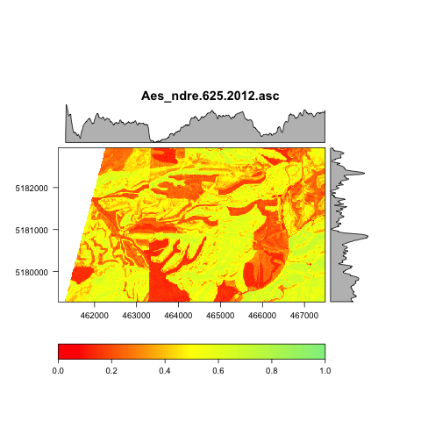
RapidEye Images
Swath Covering Single Farm
Notes:
2 Michael

Slide 6
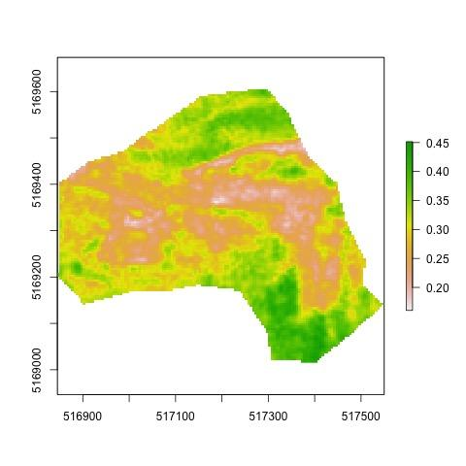
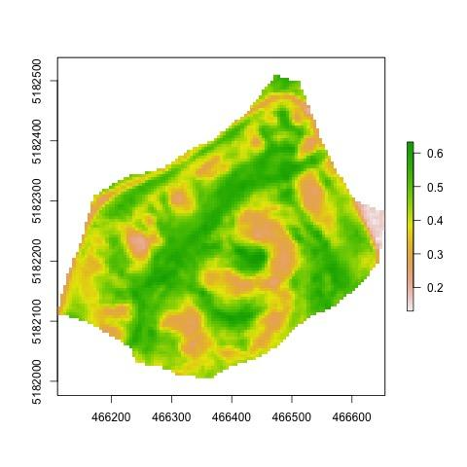
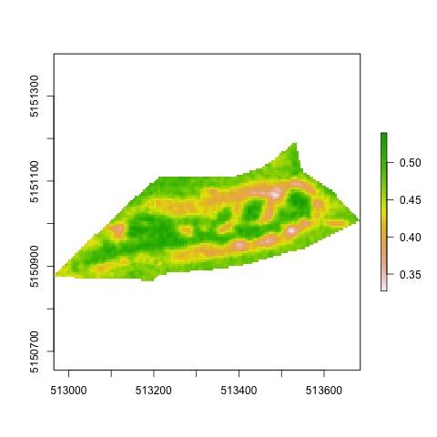
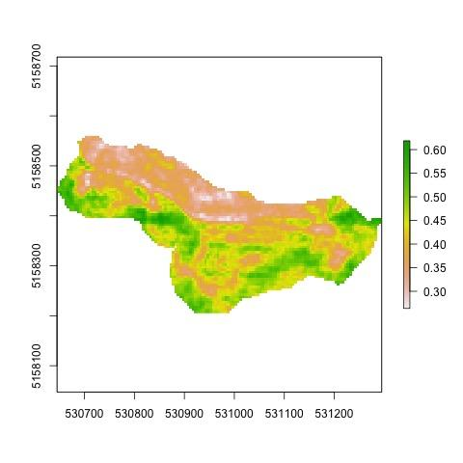
RapidEye Images:
Cropped Images by Field Site Shapefiles
Notes:
2 Michael

Slide 7
Satellite Images Over Single Growing Season
Notes:
2 Michael

Slide 8
Soil Moisture Data
10 soil moisture readings across three growing seasons
Measurements at four depths at 12 locations per farm (4 farms)
Data to be converted from Excel to .csv for import into R/Python
Notes:
3 Dane

Slide 9
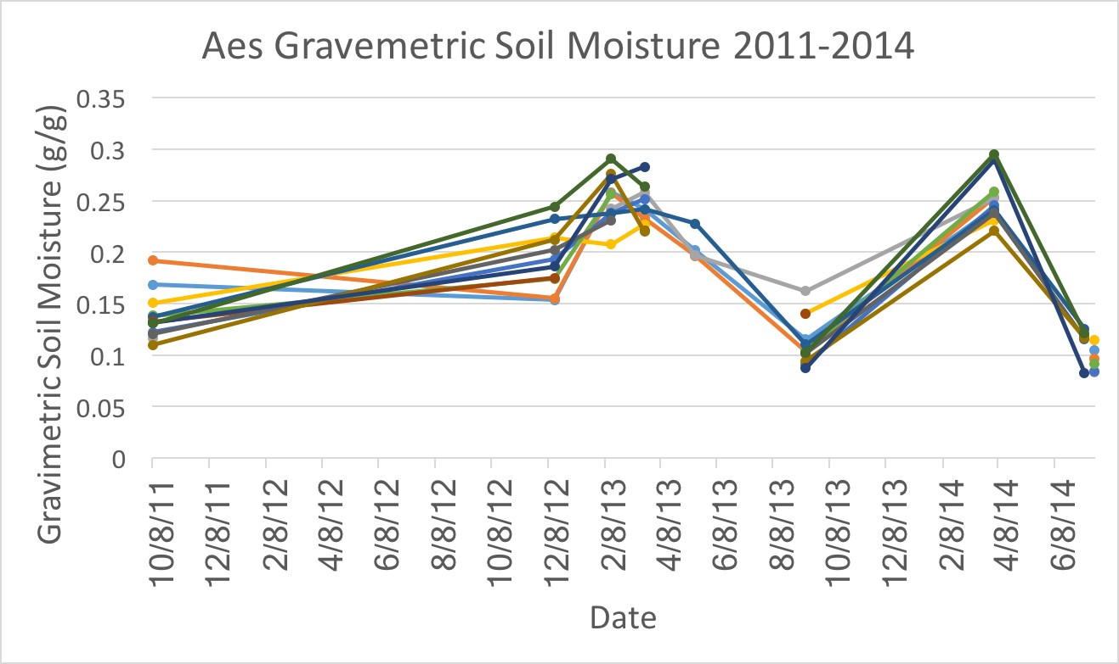
Soil Moisture Data
Notes:
3 Dane

Slide 10
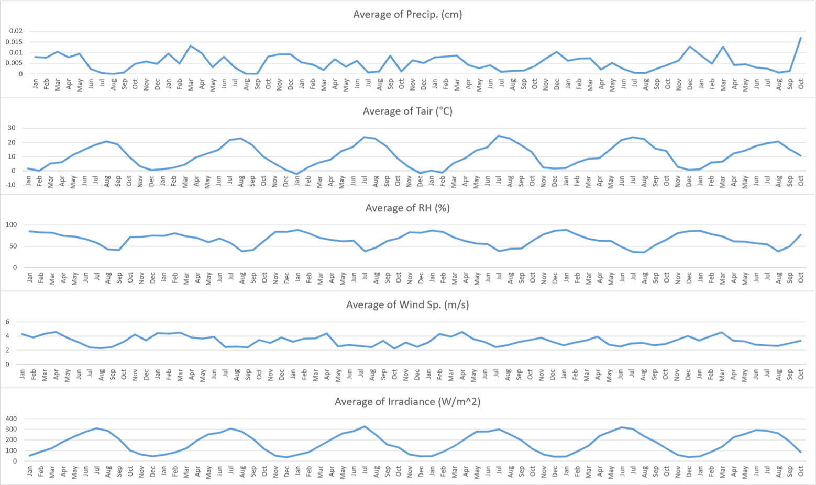
Weather Data
Notes:
3 Dane

Slide 11
Challenges due to Sparse Data
Soil Moisture
Physical model - We will investigate using a physical model to add more soil moisture data. Currently the response variable (soil moisture) is highly sparse.
Impute adjacent pixels around soil moisture sensors.
Spectral Images from Satellites
Additional NDRE images - We have obtained a license to gather 10,000 square feet of additional spectral images per month.
Due to cloud cover, several of the current images available do not provide much data. We will need to see if the current images are the full extent.
Notes:
4: Rex

Slide 12
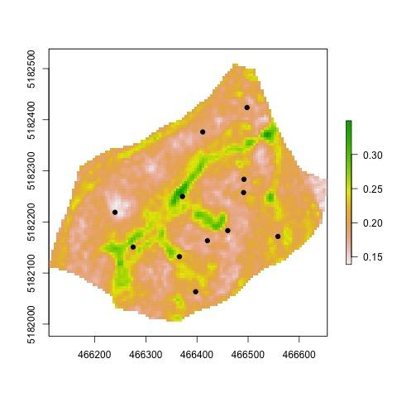
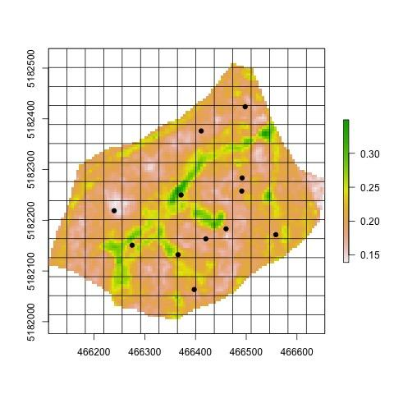
Soil Moisture Sensors Locations
Imputation
Notes:
4 Rex

Slide 13

WOODY THOMPSON SAYS
“THANK Y’ALL!!!”

